Slide 1



Using Software Quality and Algorithm Testing to Verify a 1-Dimensional Transport Model
World Environmental and Water Resources Congress
Palm Springs, May 23, 2011
Eli Ateljevich
Jamie Anderson
Kaveh Zamani
Fabian Bombardelli
Modeling Support Branch, Bay-Delta Office
Department of Water Resources
Civil & Environmental Engineering Dept.
University of California, Davis

Slide 2
Outline
Why verification?
STM
Software testing
Convergence and accuracy
Transport test suite
Detected errors
Result

Slide 3

Verification: Finding a Bug in Jungle
Verification
DSM2
Software test
Convergence
Test Transport
Bugs
Results
Notes:
Bugs, Silent Bugs, ASME editorial policy 1986, and the Picture of Forest , Failures in engineering designs

Slide 4

Verification: Finding a Bug in Jungle
Verification
DSM2
Software test
Convergence
Test Transport
Bugs
Results
Notes:
Bugs, Silent Bugs, ASME editorial policy 1986, and the Picture of Forest , Failures in engineering designs

Slide 5
Verification
DSM2
Software test
Convergence
Test Transport
Bugs
Results
DSM2 Sediment Transport Module
HYDRO
1-D flow, velocity, depth, and water surface elevations
STM
1-D sediment transport model
QUAL
1-D fate and transport of conservative and non-conservative constituents
PTM
Quasi 3-D transport of neutrally buoyant particles
Structure of DSM2
Notes:
STM operator algorithms, Splitting , Conservative form of governing equation possibility of use for any kinetically controlled reactive transport

Slide 6

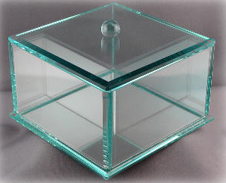
Software Testing: General
Verification
DSM2
Software test
Convergence
Test Transport
Bugs
Results
Black box testing and Glass box testing
Silent testing
Testing of legacy programs
Regression testing
Notes:
System testing: Black box testing versus glass box.
Grey box testing happens when you know what the code is like but lack of testability makes it impossible, which is common with legacy models
Silent testing

Slide 7


Fortran Unit Test (FRUIT)
Verification
DSM2
Software test
Convergence
Test Transport
Bugs
Results
The only real issues are culture and will!
Main Unit
Test Module
Test_extrapolate
Test Sub A
Advection
Test Sub A
Subroutine C
Subroutine C
Extrapolate
Subroutine A
Subroutine A
Subroutine A
Test Sub B
Test Sub B
Test_flux_limiter
Flux Limiter
Subroutine B
Subroutine B
Subroutine B
Test Sub C
Test Sub C
Test_advection
Diffusion
Test Sub D
Test Sub D
Subroutine D
Test_diffusion
Unit testing frame work in software QC
Unit testing frame work in software QC

Slide 8
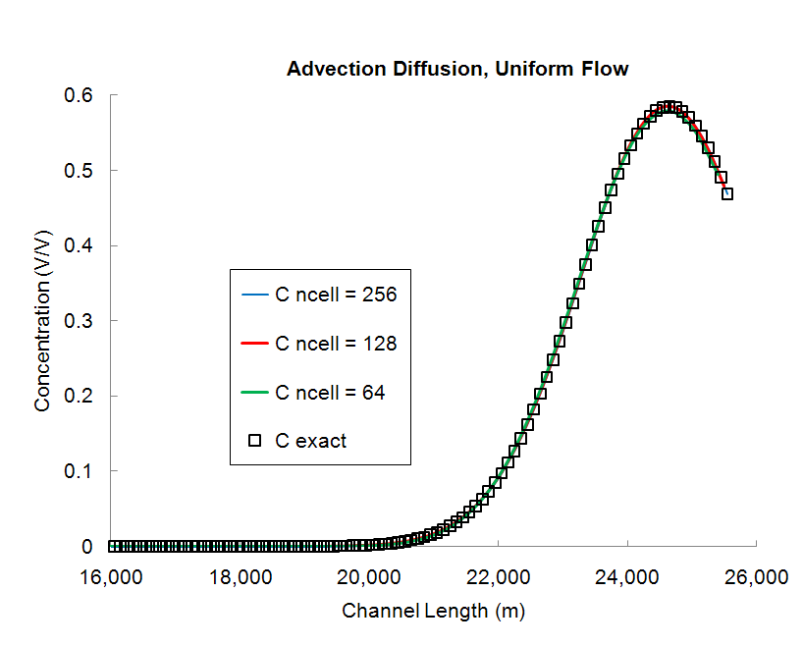
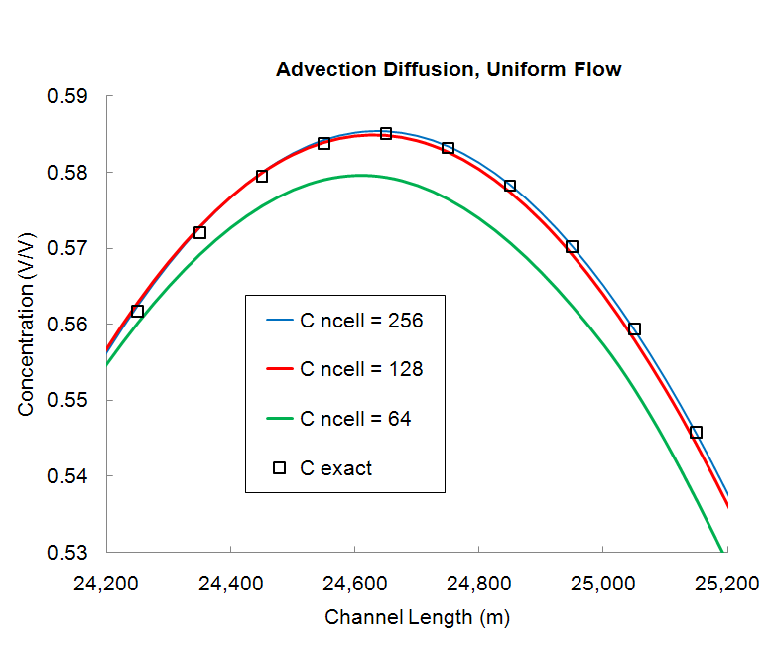
Convergence
Verification
DSM2
Software test
Convergence
Test Transport
Bugs
Results
Testing versus analytical solution
Richardson Extrapolation
Method of Manufactured Solution
Prescribed Forcing Method
Perturbation
Using Symmetry
Error analysis
Notes:
Mesh convergence study , lax theorem

Slide 9
Are convergence tests enough?
Verification
DSM2
Software test
Convergence
Test Transport
Bugs
Results
No! They are brutal. They expose bugs. But they leave behind some bugs as well.
A
Error
B
Error
Machine precision
exceeds round off error
a
b
I
II
III
1
1
Nominal scheme’s order of accuracy (2)
Order of Converge
2≈a > b
Computer
precision
1
1
Grid Size
Grid Size
After Leveque, 2002
Notes:
They have reputation for being enough, but:
Conflicting job description between obtaining results for publication and finding bugs.
Some features are turned off during convergence testing
Impossible to arrange for special cases to be triggered
Traversing these issues requires some experience
ADD the figure by Leveque 2002

Slide 10
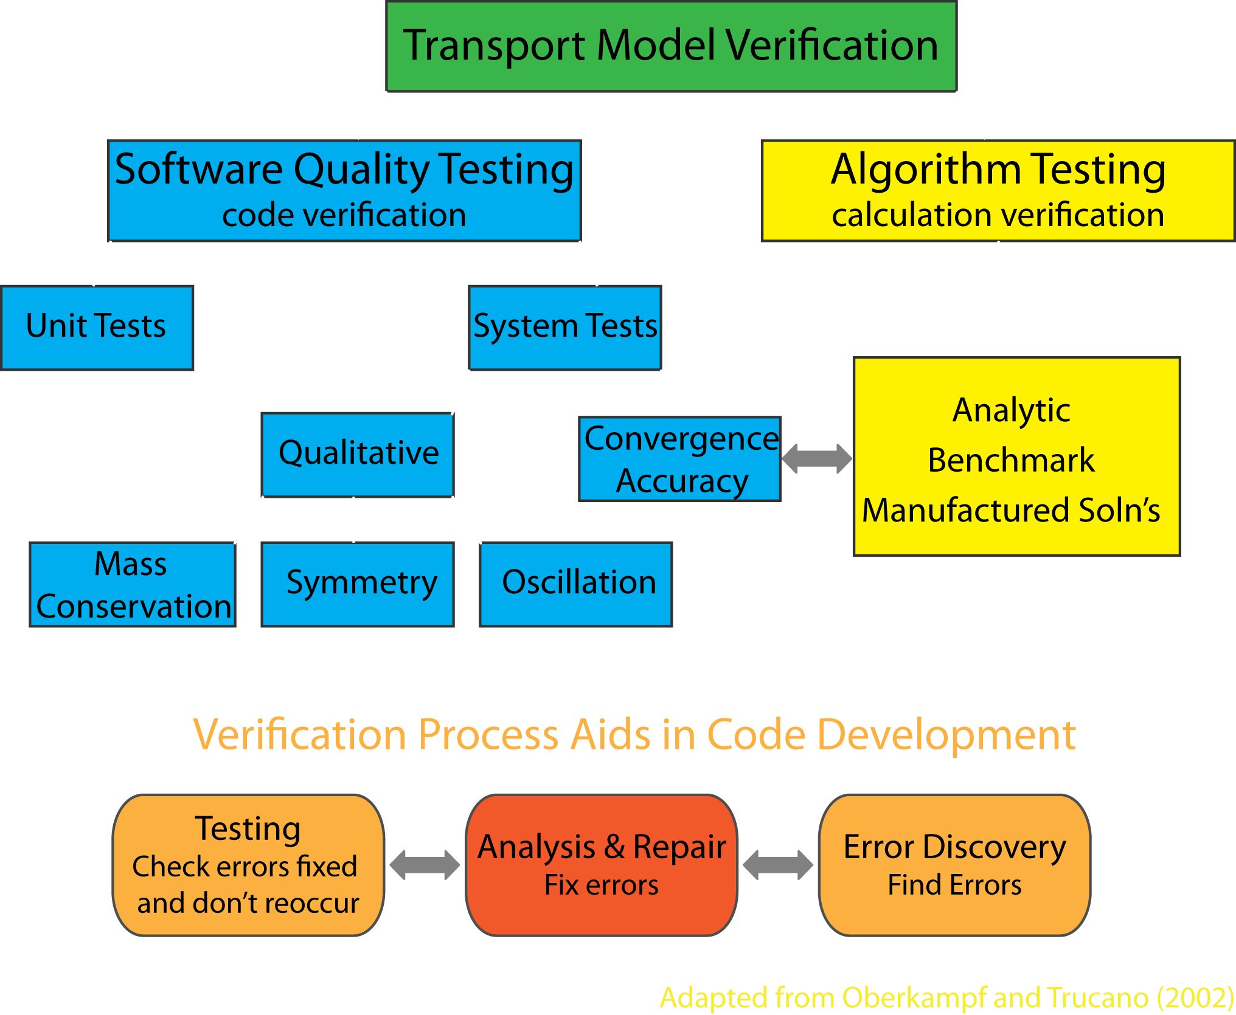
Transport Test: Structure
Verification
DSM2
Software test
Convergence
Test Transport
Bugs
Results
Adapted from Oberkampf and Trucano, 2002

Slide 11
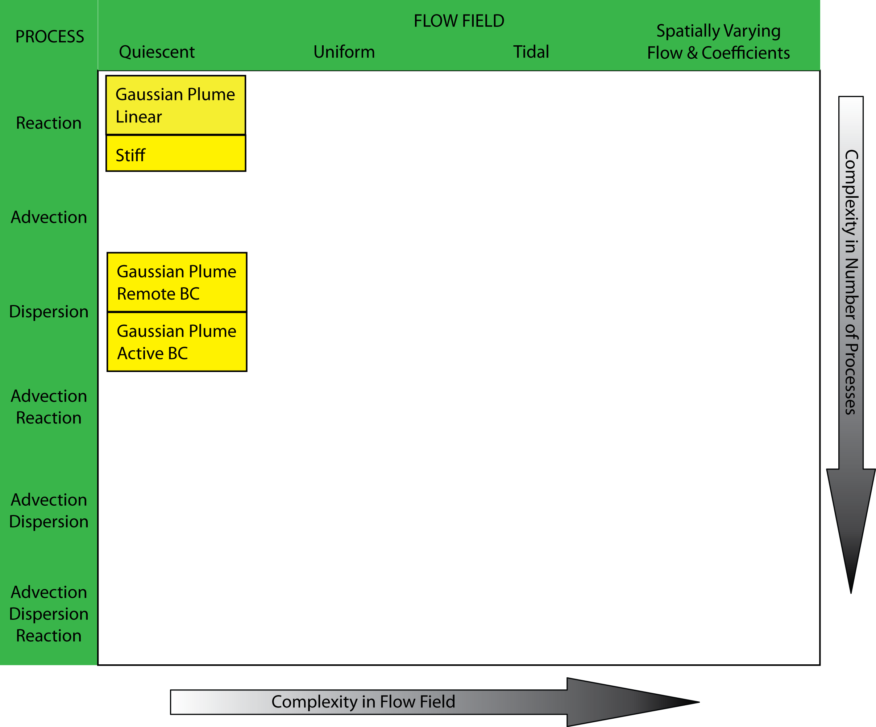
Layering in complexity
Verification
DSM2
Software test
Convergence
Test Transport
Bugs
Results

Slide 12
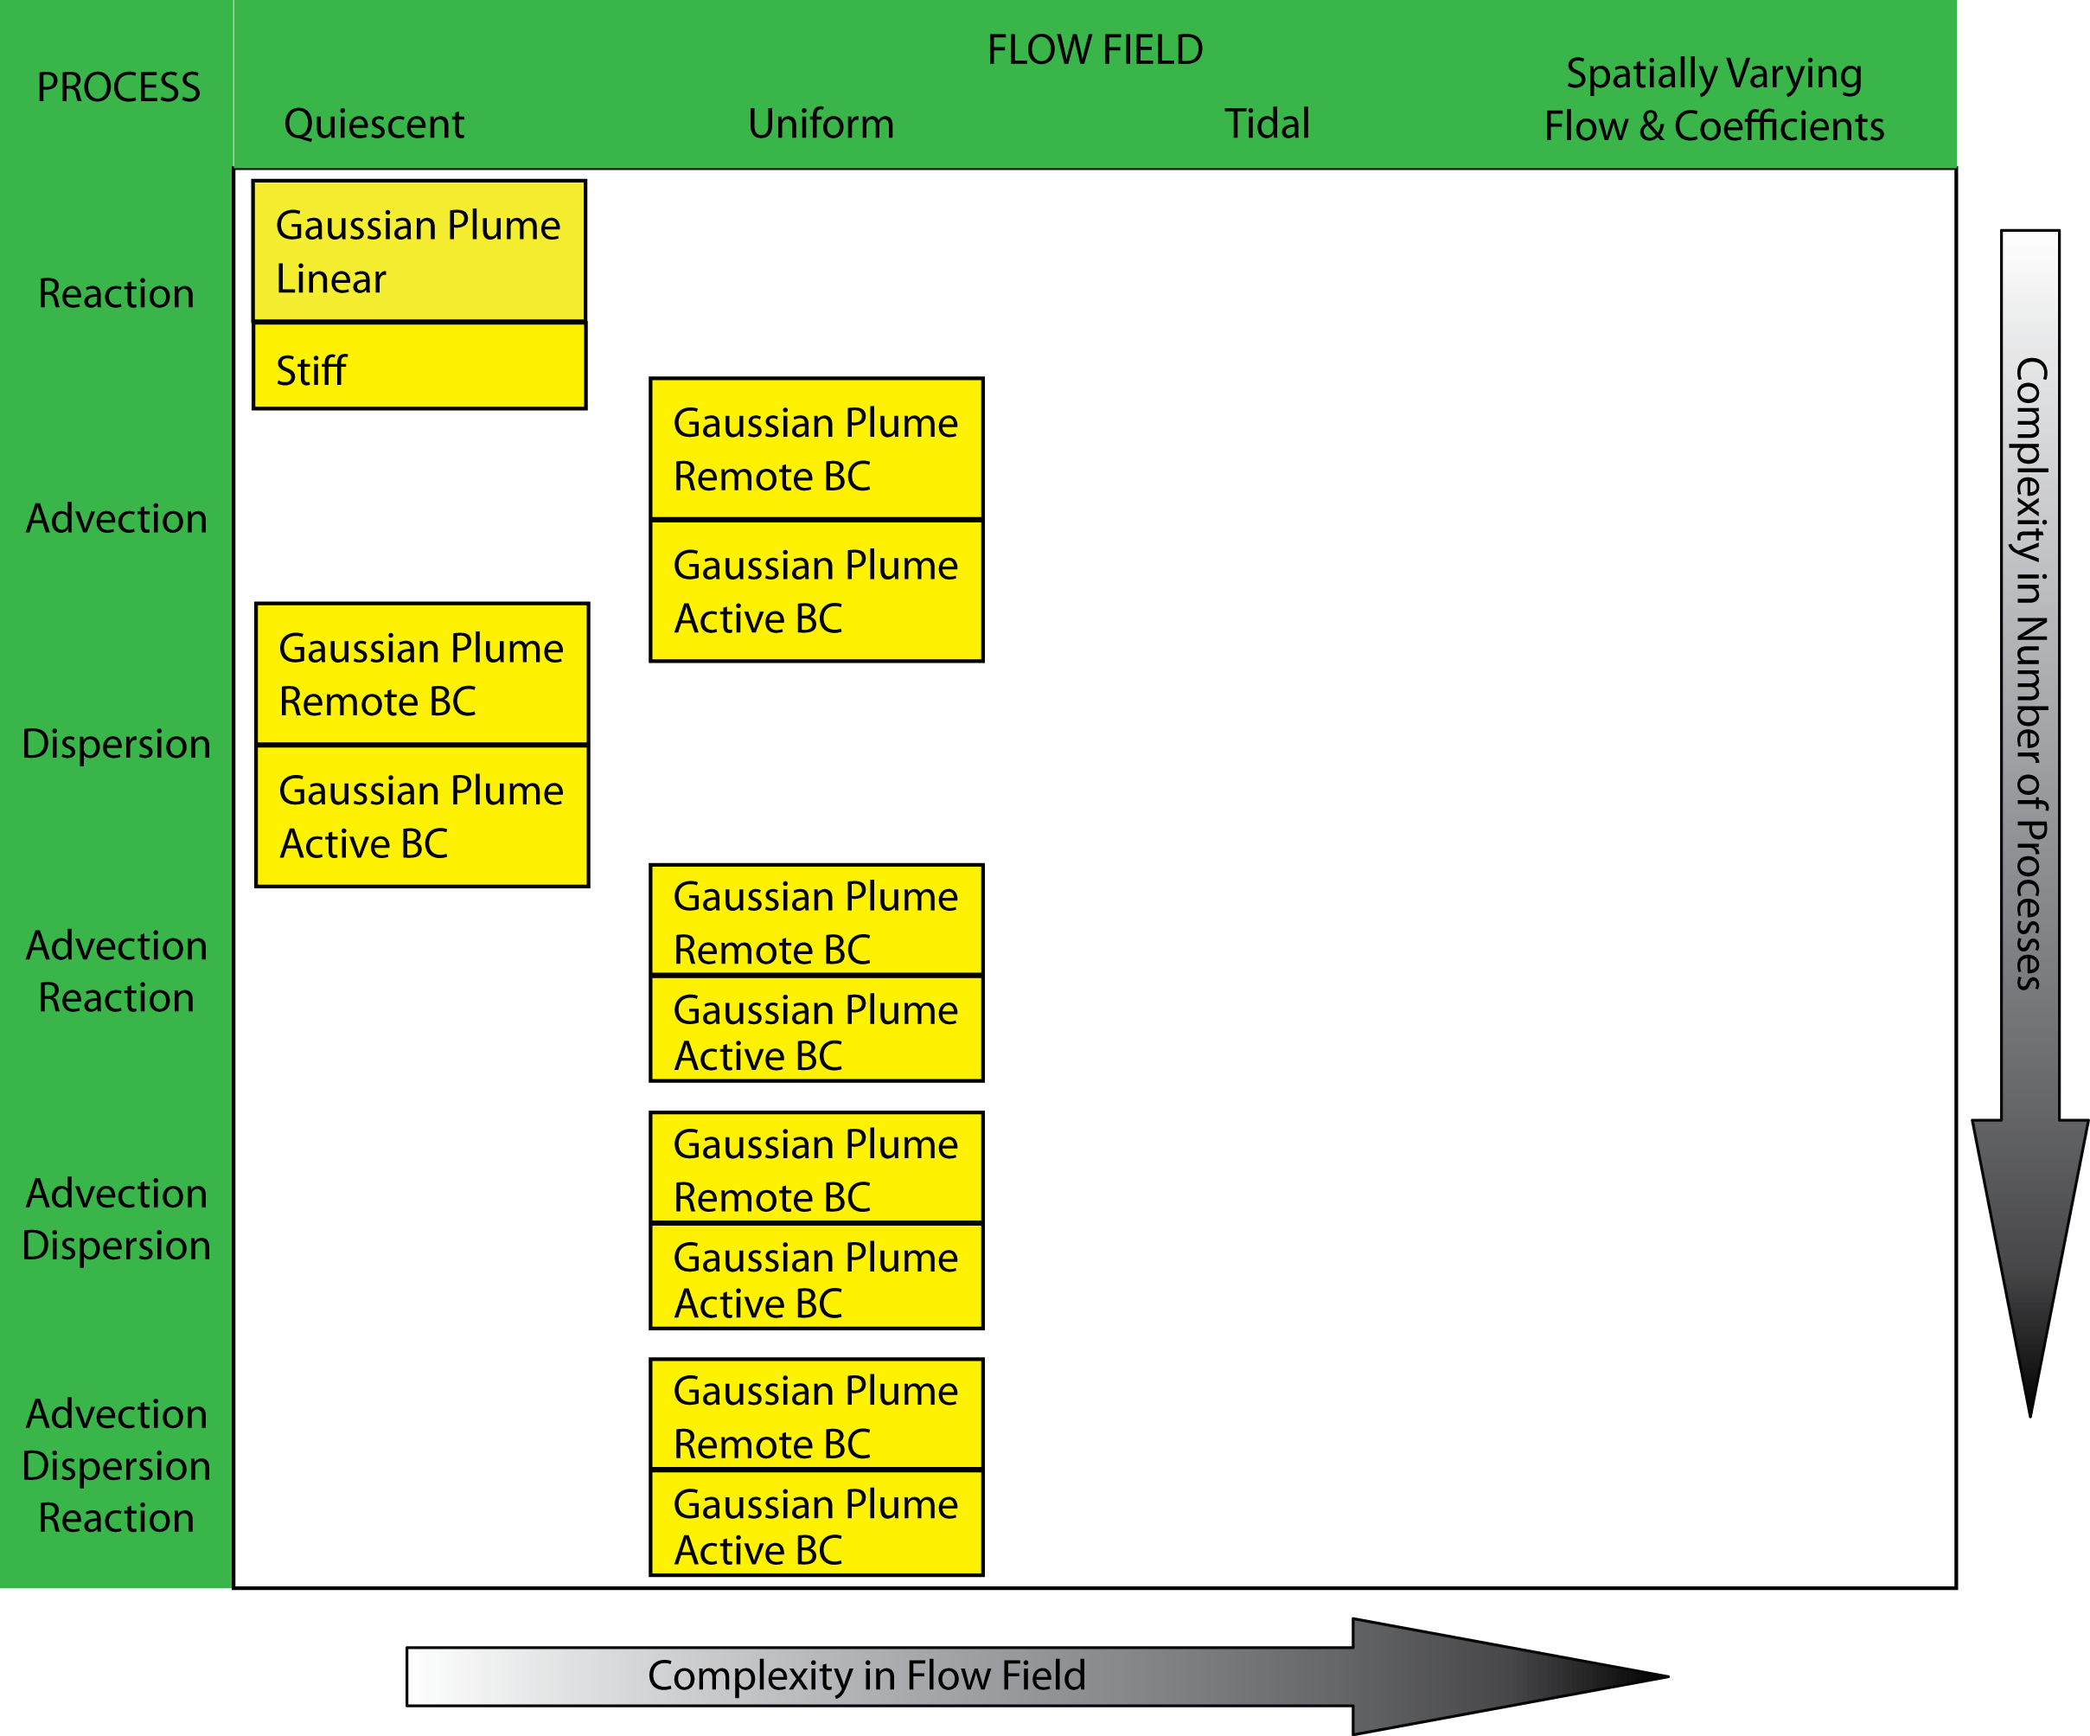
Verification
DSM2
Software test
Convergence
Test Transport
Bugs
Results
Layering in complexity

Slide 13
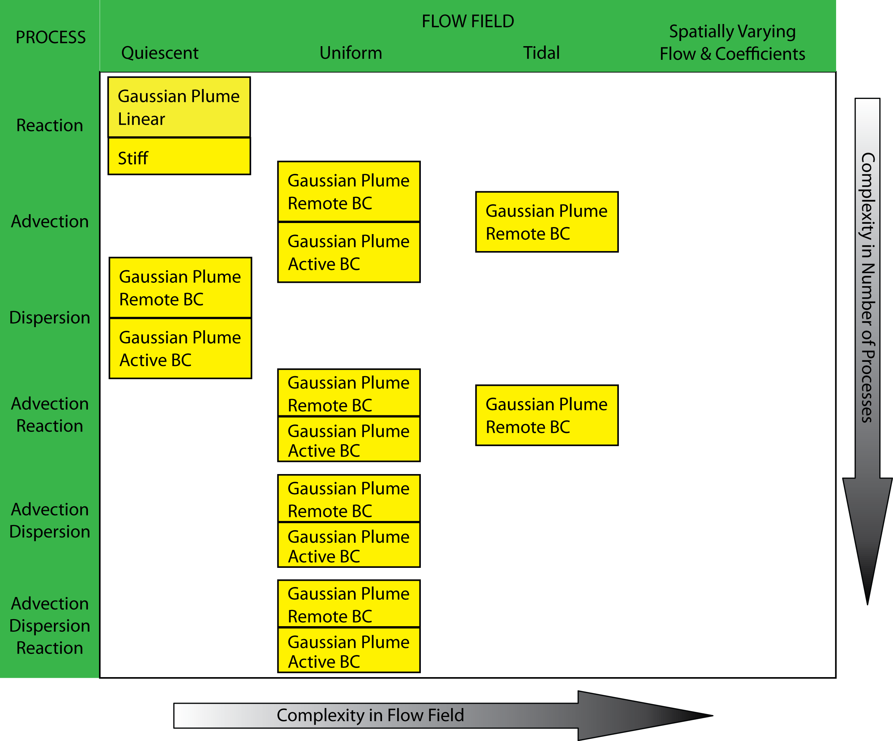
Layering in complexity
Verification
DSM2
Software test
Convergence
Test Transport
Bugs
Results

Slide 14
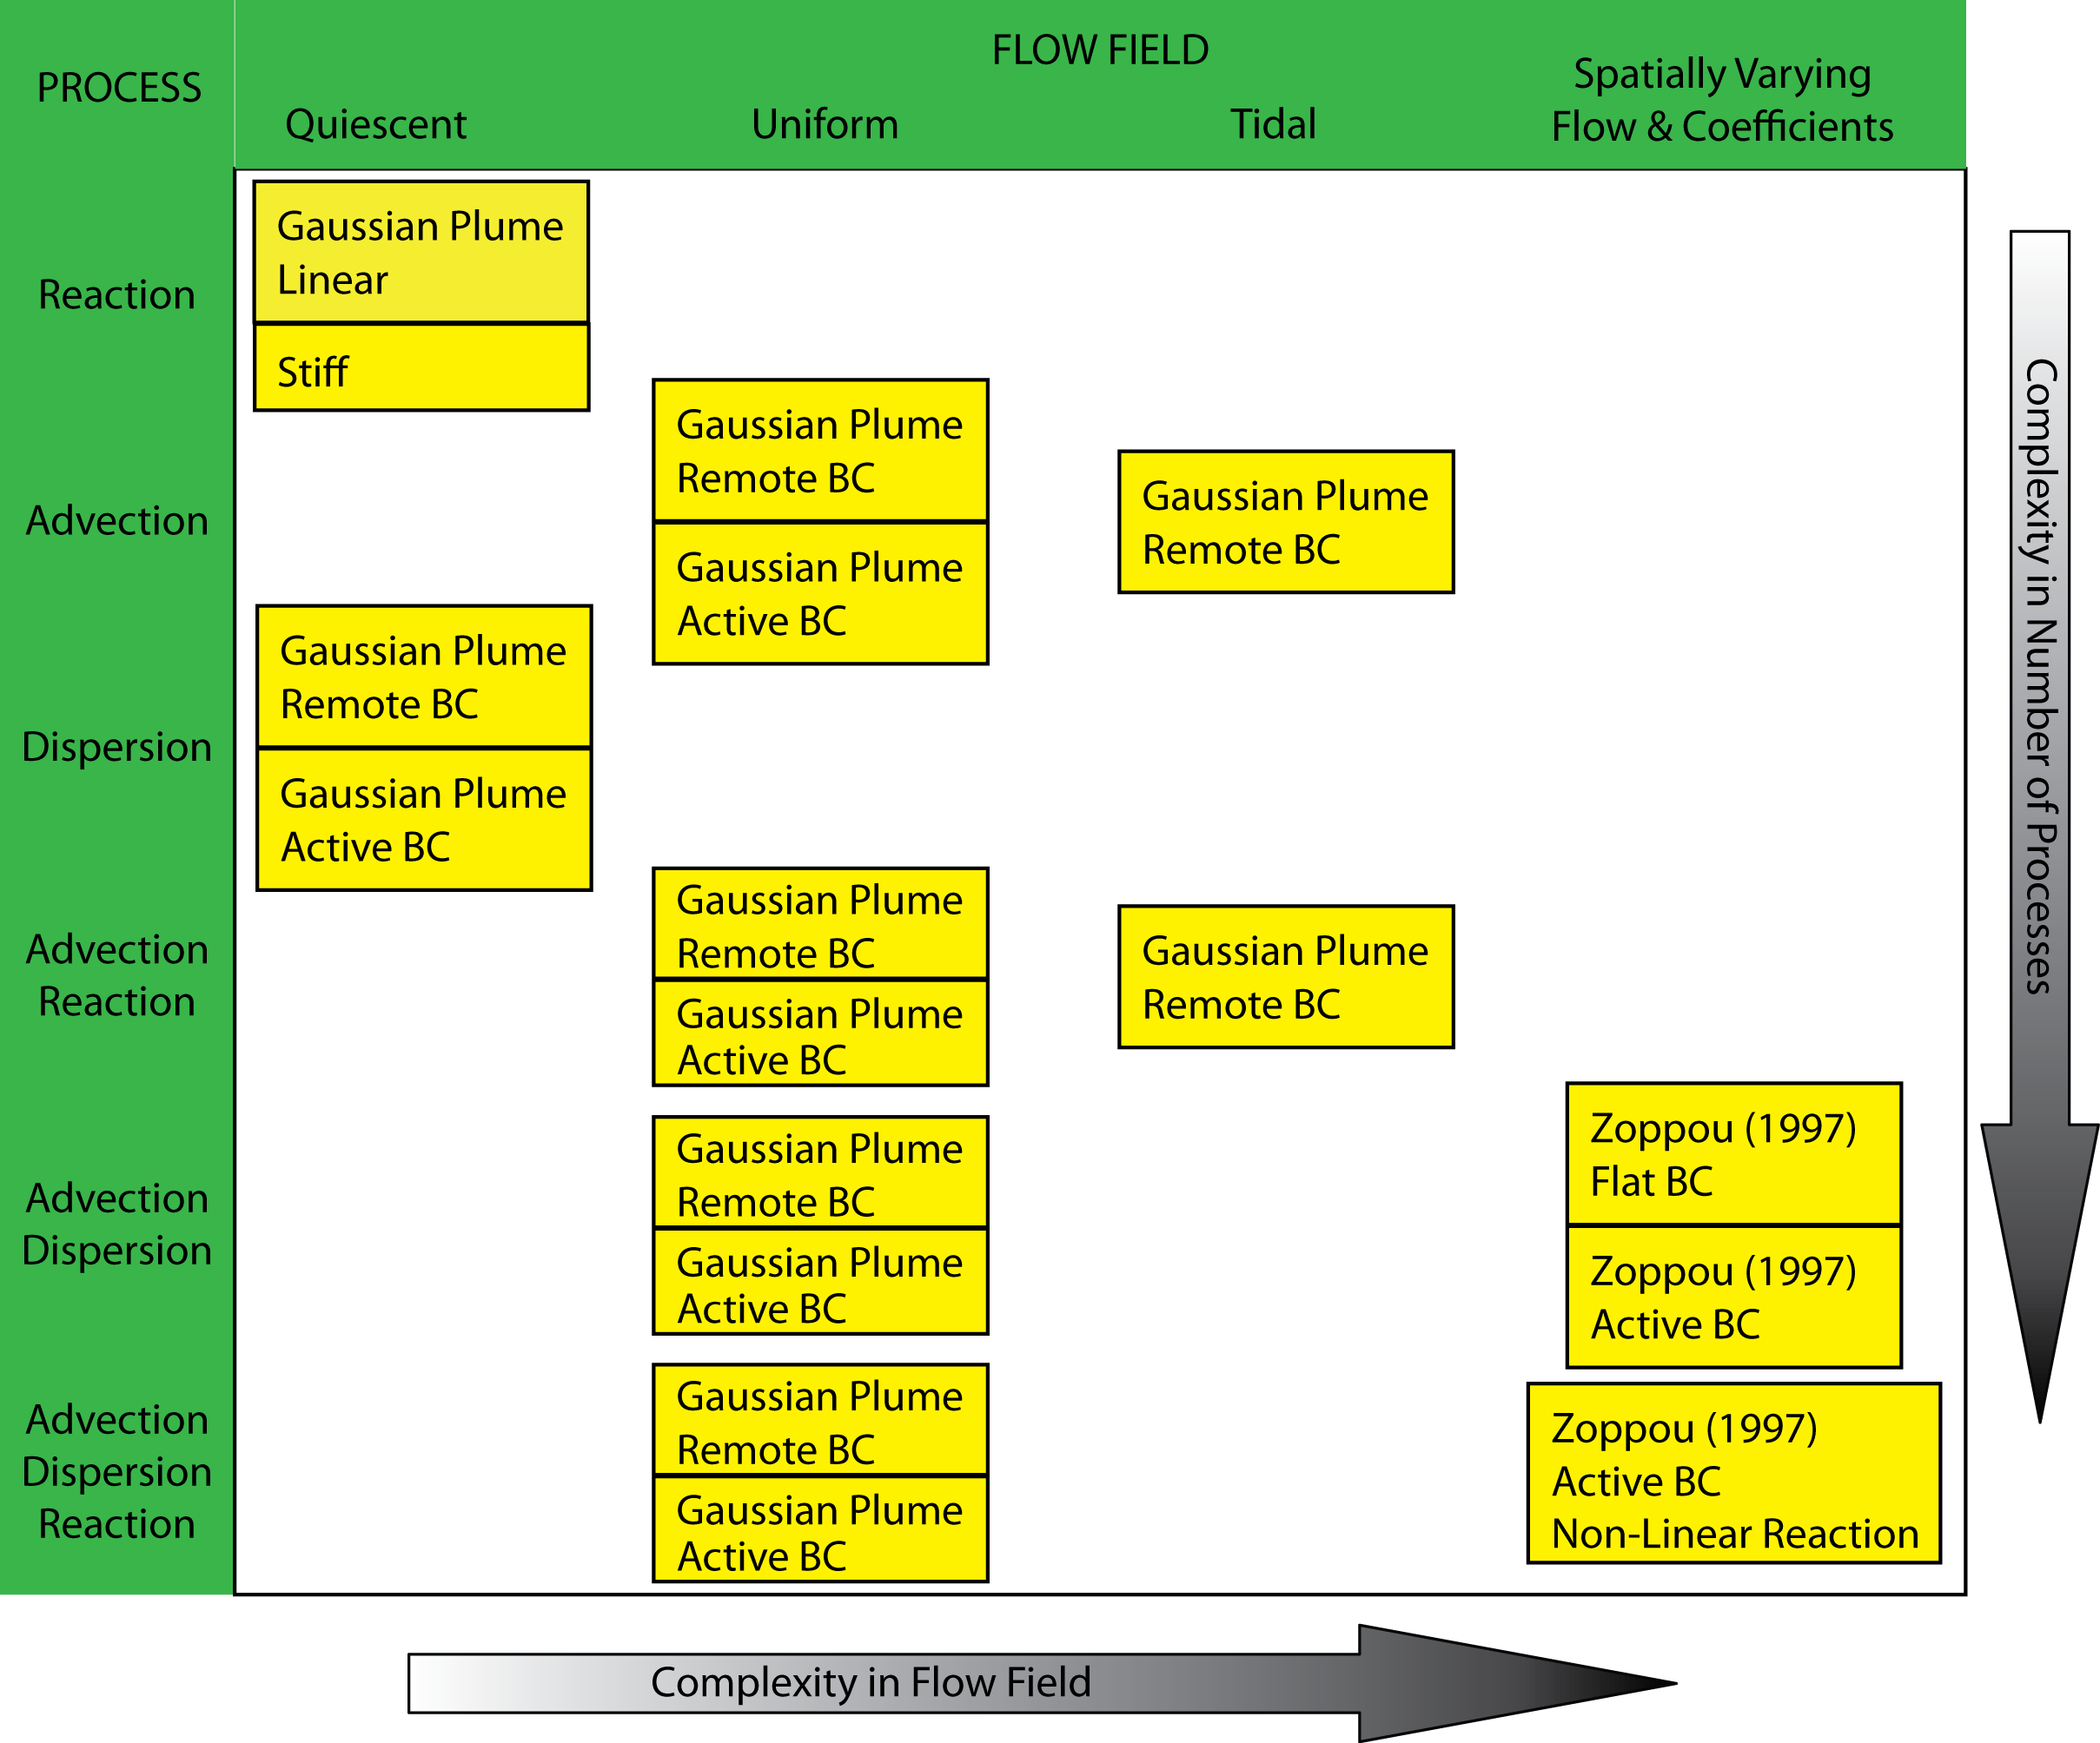
Layering in complexity
Verification
DSM2
Software test
Convergence
Test Transport
Bugs
Results

Slide 15
Example: Advection Diffusion
Verification
DSM2
Software test
Convergence
Test Transport
Bugs
Results

Slide 16
Results: Advection Reaction Tidal
Verification
DSM2
Software test
Convergence
Test Transport
Bugs
Results

Slide 17
Bug: Logical error in Advection
Verification
DSM2
Software test
Convergence
Test Transport
Bugs
Results
Notes:
Error advection source term inconsistency

Slide 18
Bug: Syntax error in Diffusion
Verification
DSM2
Software test
Convergence
Test Transport
Bugs
Results
Notes:
miss indexing in diffusion

Slide 19
Final Remarks
Verification
DSM2
Software test
Convergence
Test Transport
Bugs
Results
Verification is one part of “getting the right answer for the right reason”
We have a really complete test suite
May help solve the “grey literature” issue
Methods of Computer Science are there to guarantee the results in computational fluid mechanics
STM is second order or O(1)/accurate
We know where the algorithmic weakness are (and they are minor)

